Slide 1
Introduction to Organic Certification
Heather Holliday, Assistant Director
Jill Robinson, Program Coordinator Upstate
Catherine McGuinn, Program Coordinator Lower State

Slide 2

Topics
Interest in Organic Products and Market Trends
Meaning of Organic
Who Sets the Rules and Stakeholder Responsibilities
Organic Certification Process
Organic System Plan
Organic Practices
Labeling, Recordkeeping, Audit Considerations
Enforcement
Resources

Slide 3
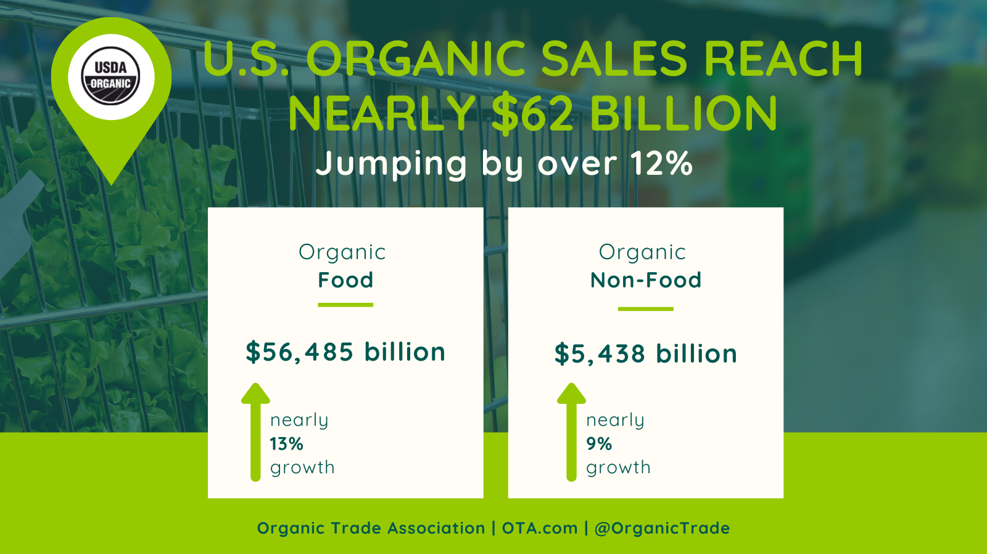
Interest in Organic Products and Market Trends
“The only thing that constrained growth in the organic food sector was supply,” said Angela Jagiello, Director of Education & Insights for the Organic Trade Association.
“Across all the organic categories, growth was limited by supply, causing producers, distributors, retailers and brands to wonder where numbers would have peaked if supply could have been met!”
Information from the Organic Trade Association: https://ota.com/news/press-releases/21755

Slide 4
Interest in Organic Products and Market Trends
Organic Trade Association survey says swing to home cooking in pandemic ignited sales
OTA Press Release from May 25, 2021
(referring to 2020 market information)
organic produce sales rose by nearly 11% to sales of $18.2 billion
more than 15% of the fruits and vegetables sold in this country now are organic
frozen and canned fruits and vegetables also jumped with frozen sales alone rising by more than 28%
organic spice sales jumped by 51%, more than 3X the growth rate of 15% in 2019
sales of organic flours and baked goods grew by 30%
Sales of organic household products saw record growth of 20%.
Information from the Organic Trade Association: https://ota.com/news/press-releases/21755

Slide 5
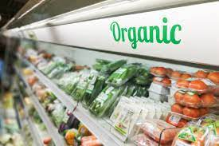
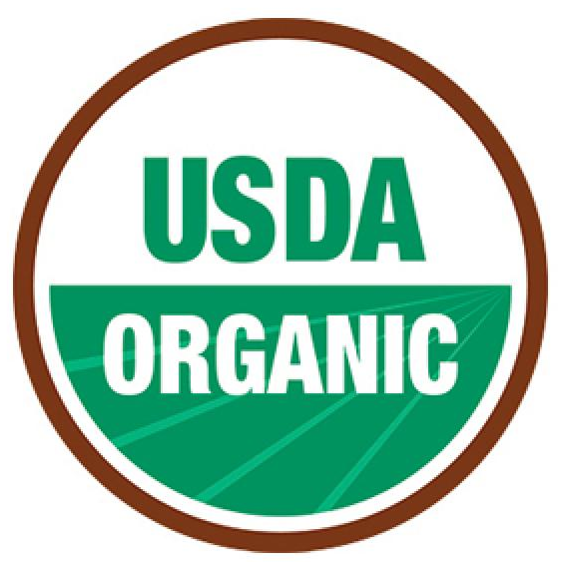
What does the term “Organic” mean?
Organic is:
Organic is not:
A marketing/labeling term that applies only to agricultural products
Verification that products were produced and handled in accordance with the Organic Food Production Act of 1990 and USDA organic regulations
A comprehensive assessment of the farm operation that occurs through review of the operation-specific Organic System Plan (OSP) and on-site inspections
Focused on the cycling of resources, promoting ecological balance, and conserving biological diversity
Produced using non-approved synthetic chemicals or fertilizers, genetic engineering, irradiation, or sewage sludge
A food safety claim
A food nutrition claim
A term that can be applied to nonagricultural products

Slide 6
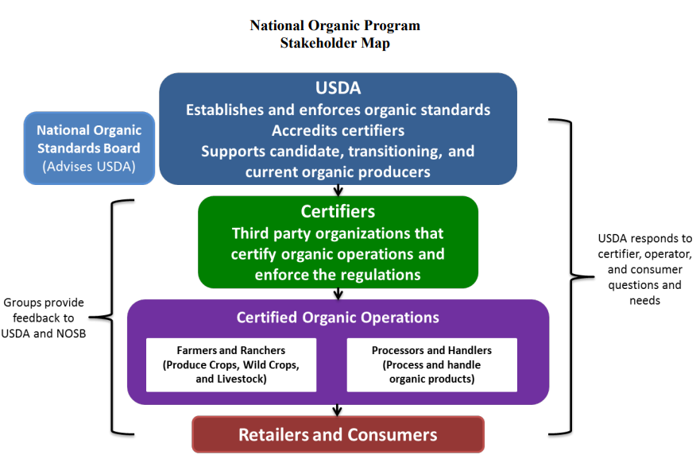
Who sets the Organic rules and how are they enforced?
Notes:
The NOP is under the USDA’s Agriculture Marketing Service and it develops regulations or “standards” for organic crop production, livestock production, and processing and handling. The NOP ensures the enforcement of these regulations through the accreditation of certifying agents. Information about the NOP, organic regulations, and guidance documents can be found here: https://www.ams.usda.gov/about-ams/programs-offices/national-organic-program
Graphic from https://apps.ams.usda.gov/organic/201/Organic201-Aug2012.pdf

Slide 7
Organic Certification Stakeholder Responsibilities
USDA National Organic Program
Accredited Certifying Agent
The USDA NOP…
sets the regulations for which organic operations are evaluated against
accredits certifying agents and grants them the ability to declare an operation as certified USDA organic
investigates the misuse of the organic brand or other organic program infringements.
The USDA NOP does not…
certify individual operations
An Accredited Certifying Agent…
completes all activities to maintain accreditation
reviews an operation’s organic system plan
completes both announced and unannounced inspections of operations they certify
issue organic certification and other notices to the operation
An Accredited Certifying Agent does not…
provide consulting services to obtain or maintain certification
respond to allegations of misuse of the organic label or claims of fraudulent practices related to organic operations

Slide 8
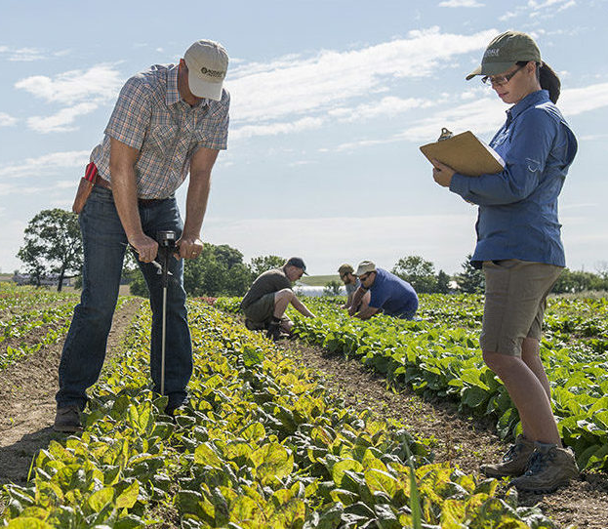
Organic Certification Stakeholder Responsibilities
Certified Organic Operation
A Certified Organic Operation…
Conducts their operation in accordance with organic standards
Submits and maintains the Organic System Plan (OSP)
Remits all fees to the Certifying Agent
Allows and has representatives available for announced or unannounced inspections of all areas, organic and non-organic
Maintains applicable records for not less than 5 years
Notifies the certifier immediately if application or drift of a prohibited substance occurs.
A Certified Organic Operation does not…
Use the organic label before becoming certified or after certification is surrendered, suspended, or revoked.
Notes:
Notify the certifier immediately if application or drift of a prohibited substance to the field, production unit, site, facility, livestock, or product is part of an operation.

Slide 9
Initial Certification and Recertification Process
Producer or handler adopts organic practices; submits the OSP and additional materials as needed, and pays fees to the Certifying Agent
Certifying Agent reviews materials to verify it is sufficient and practices comply with the USDA organic regulations.
Inspector conducts an on-site inspection of the applicant’s operation.
Certifying Agent reviews the application and the inspector’s report to determine if the applicant complies with organic regulations and issues a decision.
Certifying Agent issues an organic certificate to the operation.
The operation provides updates to the OSP either as they occur or annually at the time of renewal.
Operations may obtain certified at anytime.
March 1st is the renewal deadline for all operations regardless of the initial certification date.
Inspections for recertification occur between March 1 and September 1.

Slide 10
Clemson University Organic Certification Fees
$750 initial certification fee includes review, inspection (time and travel), and final review/certification decision
Recertification fees consist of a $200 application fee plus an assessment fee equal to 0.5% of the previous year’s gross organic sales
  Fees are capped at $7,500 annually, which is equal to $1,500,000 in gross organic sales
Clemson online fee payment option: https://www.clemson.edu/public/regulatory/organic/payonline.html
National Organic Certification Cost Share Program (NOCCSP)
  Rebate equal to 50% of annual certification fees up to $500
  Administered by the USDA Farm Service Agency

Slide 11
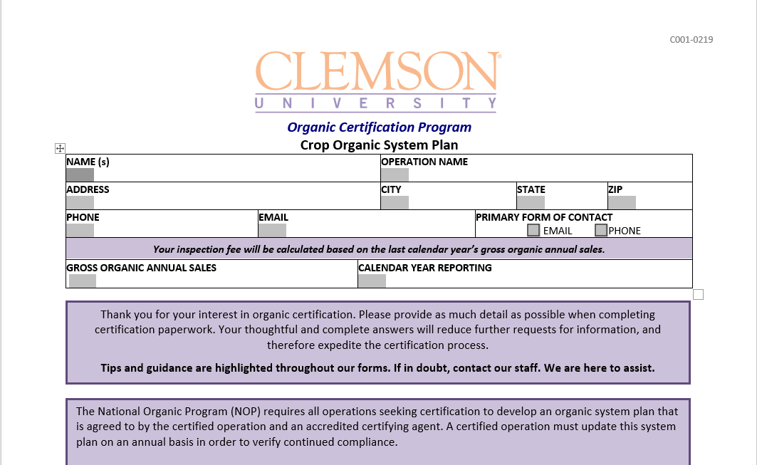
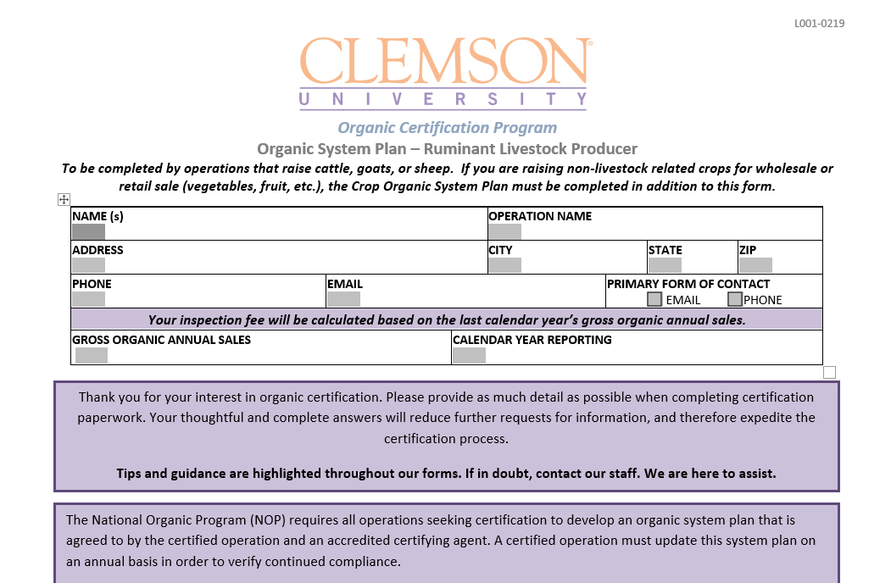
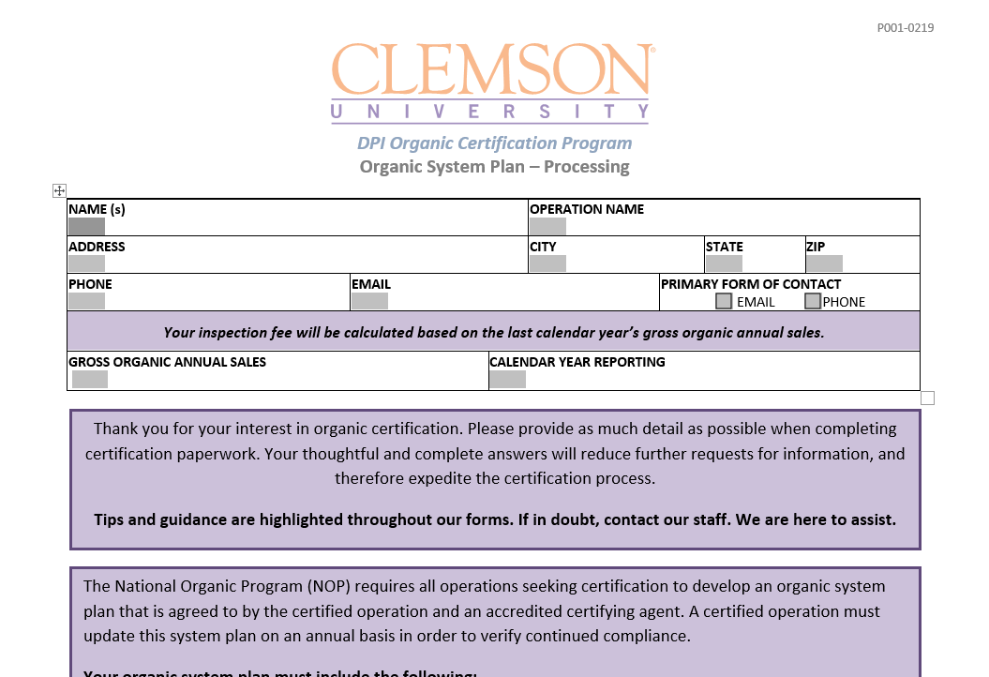
Organic System Plan (OSP)
The OSP Contains…
A description of practices and procedures to be performed and maintained, including the frequency with which they will be performed
A list of substances used in production or handling, indicating its composition, source, and location(s) where it will be used
A description of the monitoring practices to ensure organic integrity
A description of the recordkeeping system
A description of the management practices and physical barriers established to prevent commingling and/or contamination with non-organic materials
Any information required by the certifying agent that aids in the evaluation of compliance
Notes:
We need to know:
What you’re going to do? How you’re going to do it and what you’re doing it with? When and how often you do it? Provide evidence of what you did, records.

Slide 12
Tip for Writing an Effective OSP:
Identify and manage critical organic control points
A critical organic control point is any point or procedure in an organic production or handling system where loss of organic integrity may occur through commingling with non-organic product or contamination with prohibited substances. These points and measure the operation will take to prevent noncompliance need to be described in the OSP. Describing these points will help the reviewer and inspector more easily assess an operations ability to comply with organic regulations and standards.
The following questions about organic control points provide important information:
  What are they?
  Where do they occur?
  When do they occur?
  How does the operation achieve and maintain organic compliance?
  Who performs the actions necessary for compliance? Is the person trained properly? Does a quality control manager sign off?

Slide 13
Changes to the OSP
No Notification Required – Internal Updates to OSP | Certifier Notification Required
The dairy herd size was increased. | A dairy operation added a flock of chickens to sell organic eggs from a farm stand.
A new supplier of certified organic ingredients or animal feed has been added to the supplier list. | The company has been able to source organic celery powder, but the supplier went out of business. It is now buying non-organic celery powder. The use of non-organic agricultural ingredients has not been part of the OSP.
A new pest control service provider has been contracted, but no pest control materials have ever been used in any areas where organic materials are handled or stored. This practice is not changing. | The operation contracted a new pest control company because of its problems with moths in the grain; the pest control service contract now includes fumigation.
An operation’s internal review of its organic procedures revealed weaknesses in recordkeeping procedures. The company implemented improvements to its system. | Adjacent fields belonging to a certified organic neighbor have been sold to a conventional producer that now grows genetically modified corn. The operation needs to create additional buffers due to the change, and the OSP needs to be updated with the additional buffer zone information. The certifier should be immediately informed about this change.
Field access has been changed to a different road. | Acreage, a new field, product line, and a production facility have been added or removed.
An all-organic operation now stores its hay in a different farm-owned barn. | A dual operation moved storage of bulk materials.
A new milker was hired. | The company has been acquired by another entity.
Photos and font of the labels were changed. | A new retail label for the operation’s organic products was developed. The certifier needs to approve the label and the product, then add it to the certificate.
A new sanitation company is contracted, but all sanitation materials are based on the same active ingredients as before. | The new contracted sanitation company insists that materials not included on the National List need to be added to the approved materials list.
A certified operation may not make any changes that could affect compliance with organic regulations without first notifying their certifier. The certifying agent will ensure that the change remains in compliance.
An operation can make changes that do not potentially affect compliance and notify the certifier at the time of the annual certification renewal.
If in doubt of the change’s ability to affect compliance, contact your certifier for clarification.

Slide 14
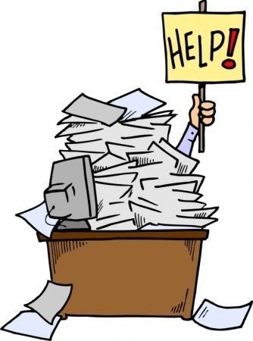
Why all the paperwork?
The OSP serves as an agreement between the certifier and the certified operation. The certifier approves an OSP based on the information provided by the operator.
The OSP is a description of the human, physical, and natural resources that a farm has as its productive capacity. When implemented, the OSP can help a business more fully develop its potential and use available resources more efficiently.
The OSP is a forward-looking management tool that helps the operator anticipate challenges and make informed decisions, rather than reacting to crises.
The OSP is an economic tool. A well-constructed OSP can help an operator budget for the coming year’s expenses and income and fulfill the potential to be viable both economically and sustainably.

Slide 15
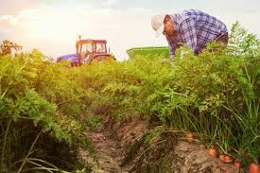
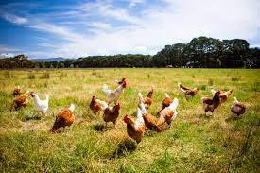
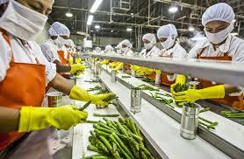
Organic Certification Requirements
Organic regulations are published in the Code of Federal Regulations (CFR 7 subsection 205).
https://www.ecfr.gov/cgi-bin/text-idx?tpl=/ecfrbrowse/Title07/7cfr205_main_02.tpl
Further guidance documents are issued by the National Organic Program in the Program Handbook.
https://www.ams.usda.gov/rules-regulations/organic/handbook
Certification can be obtained in 3 areas:
crop production, livestock production, and processing/handling

Slide 16
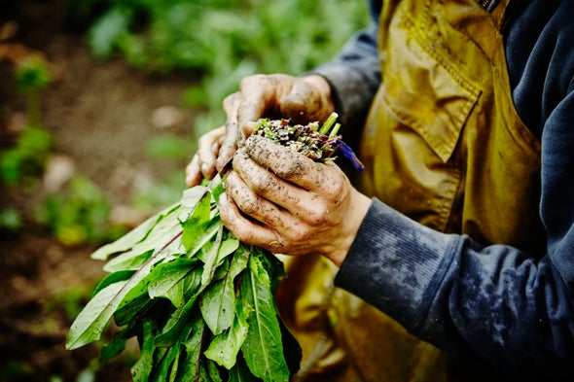
Crop Production
Crop farms must:
Implement and maintain an Organic System Plan
Maintain distinct, defined boundaries and buffer zones to prevent prohibited substances from impacting organic areas
Do not use prohibited substances, such as excluded fertilizers or pesticides
As long as the farm is certified, farmers:
MUST NOT use prohibited substances, sewage sludge, irradiation, or genetic engineering
MUST use organic seeds and organic seedlings (for annual crops), when commercially available
MUST document management of pests and weeds
MUST implement tillage and cultivation practices that maintain or improve soil conditions and minimize erosion
MAY use natural inputs and/or USDA-approved synthetic substances

Slide 17
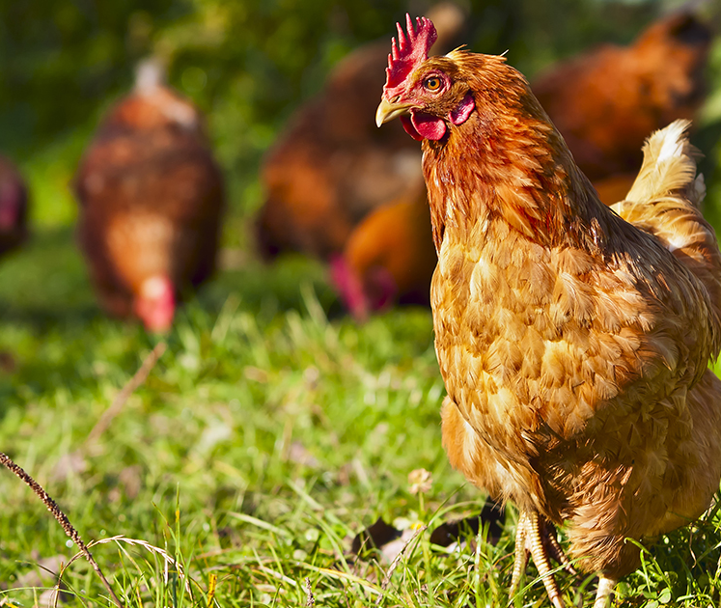
Livestock Production
Livestock operations must:
Maintain and implement an Organic System Plan
Use 100% organic feed: Feed must not contain
  antibiotics,
  growth hormones,
  slaughter byproducts, or
  genetic engineering
Provide access to the outdoors and good living conditions year-round
Maintain a pasture plan for grazing animals
Document the organic status of all animals

Slide 18
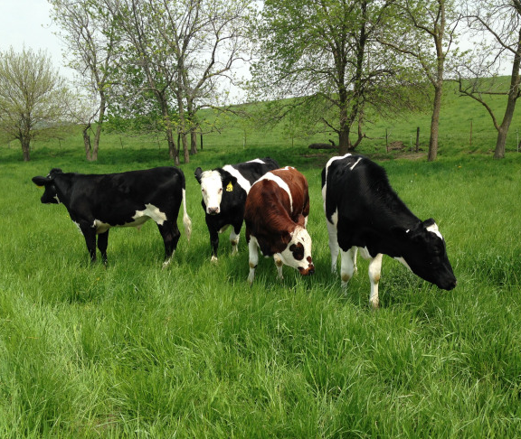
Livestock Production
Ruminants:
Must have access to pasture during the grazing season:
  30% of the animal’s dry matter intake must come from pasture
  grazing season must be at least 120 days
Must meet animal health and welfare standards
Breeding animals:
Must be managed organically no later than the last third of gestation for the offspring to be considered organic
Dairy animals:
Must be managed organically for one year before their milk may be considered organic
Poultry:
Must be managed organically from the second day of life

Slide 19
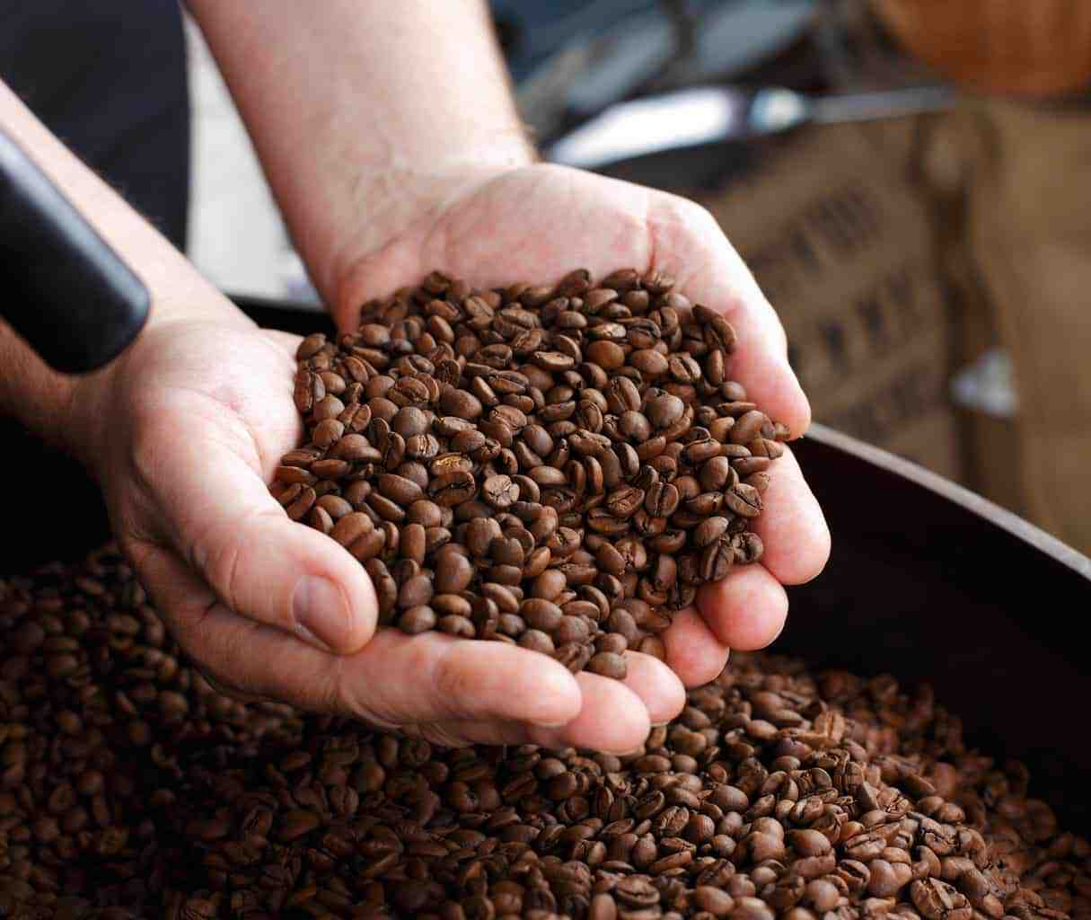
Processors and Handlers
Handling and processing operations must:
Maintain and implement an Organic System Plan
Prevent the commingling or contamination of organic products by non-organic products during processing
Prevent pests using only approved practices
Use certified organic agricultural ingredients in organically-labeled products
Use only approved label claims
Not use irradiation or genetic engineering

Slide 20
Allowed and Prohibited Substances
In general, synthetic substances are prohibited in organic products unless specifically allowed. Non-synthetic substances are allowed unless specifically prohibited.
The National List of Allowed and Prohibited Substances (National List) is part of the organic regulations. It identifies substances that may and may not be used in organic production and handling (part of the CFR)
  The National List includes:
    Synthetic substances which are allowed for use
    Natural substances which are prohibited for use.
  The National List has separate sections for crops, livestock, and handling/food processing.
Additional resources to evaluate a substance for use in an organic operation:
  Organic Materials Review Institute https://www.omri.org/
  California Department of Food and Agriculture Organic Material Input Program https://www.cdfa.ca.gov/is/ffldrs/fertilizer_OIM.html
  Washington State Department of Agriculture Organic Materials Input List https://cms.agr.wa.gov/getmedia/6322228c-c949-44a2-926c-2a86739269e3/WSDA_Organic_Input_Material_List

Slide 21
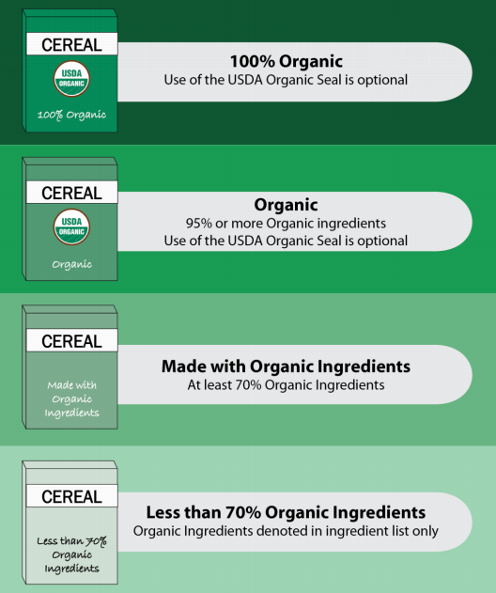
Labeling of Organic Processed Products
Leave your creative hat on the table when it comes to the USDA or Clemson Organic seal.
There are specific labeling requirements that you must follow (CFR 7…Part 205 Subsection D Labels, Labeling, and Market Information).
Labels must be approved by your certifying agent prior to use.

Slide 22
Recordkeeping
The OSP needs to include information about recordkeeping procedures in sufficient detail to ensure that the operation is complying with recordkeeping requirements and must provide traceability of inputs and products.
Insufficient information in records may include:
Harvest records that do not include the field identification
Sanitation records that do not include a signature line
No space on a form for lot numbers to record incoming ingredients
Resources to help develop recordkeeping practices:
https://attra.ncat.org/product/documentation-forms-for-organic-crop-and-livestock-producers/
https://www.ams.usda.gov/sites/default/files/media/2602.pdf

Slide 23

Special Audit Considerations
Mass Balance
Traceback
A mass balance is conducted to ensure that the amount of organic goods sold matches the production capacity of the operation based on inputs.
The intent of the traceback audit is to demonstrate that an organic product can be traced back to its origin in the operation. A product sold, finished good, or livestock is selected; the inspector attempts to identify linking elements on the client’s records (lot numbers, invoice numbers, etc.) to verify that the product (or ingredients or animal) can be traced back to the field of origin or supplier.
Inputs
Products Sold

Slide 24
Enforcement of Organic Regulations
The USDA investigates reported or suspected violations of the organic regulations, often with the help of organic certifiers
  Willful violations of the regulations may result in loss of certification (if applicable) and/or civil penalties of up to $11,000 per violation. These penalties may be levied against both certified and uncertified operations.
Anyone can report a suspected violation to the USDA: https://www.ams.usda.gov/services/enforcement/organic/file-complaint
Certifiers conduct periodic residue testing of organic products to monitor compliance
Certifiers also conduct unannounced inspections of operations to monitor compliance

Slide 25
Resources
CU Organic Program Homepage
https://www.clemson.edu/public/regulatory/organic/index.html
USDA NOP Livestock Producer Guide
https://www.ams.usda.gov/sites/default/files/media/LivestockProducersGuide.pdf
USDA NOP Crop Producer Guide
https://www.ams.usda.gov/sites/default/files/media/CropProducersGuide.pdf
USDA NOP Processor Guide
https://www.ams.usda.gov/sites/default/files/media/ProcessorsGuide.pdf
USDA NOP Handbook
https://www.ams.usda.gov/rules-regulations/organic/handbook
CU Organic Resource Page
https://www.clemson.edu/public/regulatory/organic/resources.html

Slide 26
Clemson University
Organic Certification Program Contacts https://www.clemson.edu/public/regulatory/organic/index.html
Jill Robinson
Organic Program Coordinator
Upstate
Phone: 864-646-2128
Email: jill6@clemson.edu
Sandra Verderame
Administrative Coordinator
Phone: 864-646-2131
Email: sandrav@clemson.edu
Catherine McGuinn
Organic Program Coordinator
Midlands to the Coast
Phone: 843-225-7064
Email: cpmcgui@clemson.edu
Heather Holliday
Assistant Director
Phone: 864-646-2129
Email: hmarti2@clemson.edu

