Slide 1
The Role of Packaging in Food Sustainability
Daniel McKamy CLEMSON UNIVERSITY
Cooperative Extension
Food Systems and Safety, Extension Associate
Field Operations
511 Westinghouse Road, Pendleton, SC 29670
864.905-7986
www.clemson.edu/extension/food

Slide 2
Outline
Food Waste Emerges as a Priority
Food Science and Shelf Life
Consumers Attitudes Towards Food Waste
Collaborating to Reduce Food Waste
2

Slide 3
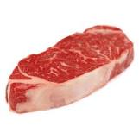
Estimates of Global Food Waste
Annual Global Food Waste as a % of Production
58%
37%
18%
Fruits & Vegetables
Cereals
Milk
23%
40%
Fish
Meat
Over one third of the food we produce is never consumed
Source: Food and Agriculture Organization of the United Nations (2011)
3

Slide 4
U.S. Retail and Consumer Food Waste
31% of retail food supply goes uneaten, valued at $162 Billion
Weight of Food Loss
Economic Value of Food Loss
Caloric Value of Food Loss
Source: USDA (2014)
4

Slide 5
US Fresh Food Sales: Percentage Sold Packaged vs Wasted (%) Euromonitor International, 2017 & ReFED 2016

Slide 6
Consumer Food Waste Causes
Shelf life of perishable foods is responsible for over 50% of loss
Source: WRAP (2013)
6

Slide 7
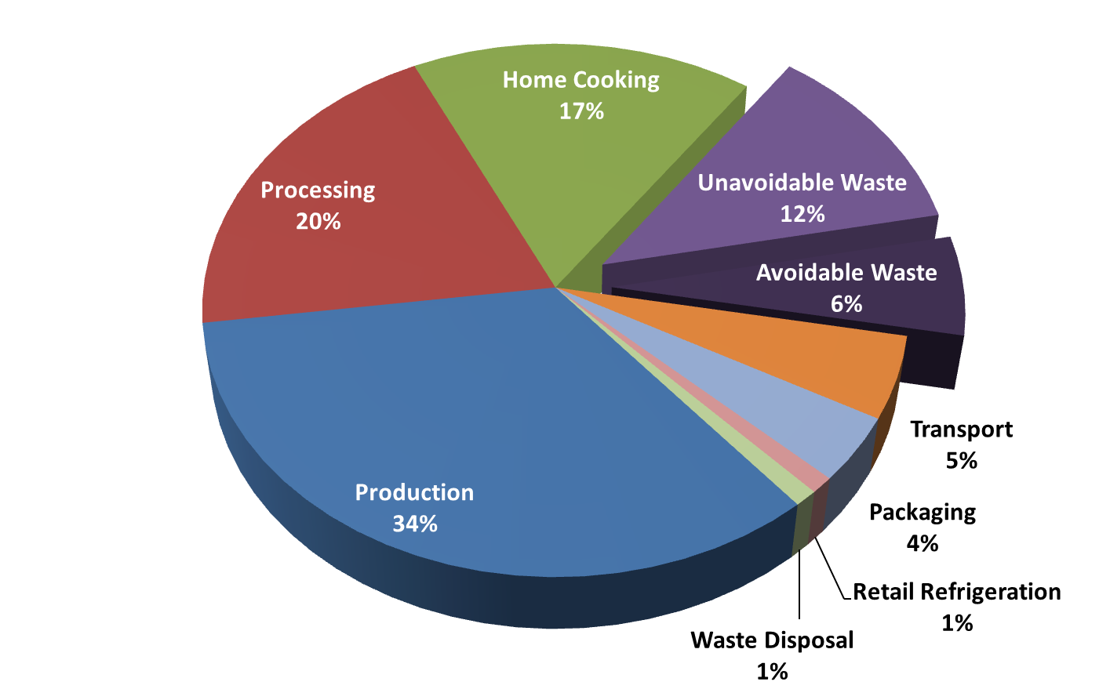
Impacts of Food in the Supply Chain
Greenhouse Gas Contributions
U.S. Poultry Supply Chain
Overall food waste environmental impact can be significant, and occurs after resources have been invested
Source: AMERIPEN Value of Packaging (2013)
7

Slide 8
Food Science and Shelf Life
8

Slide 9
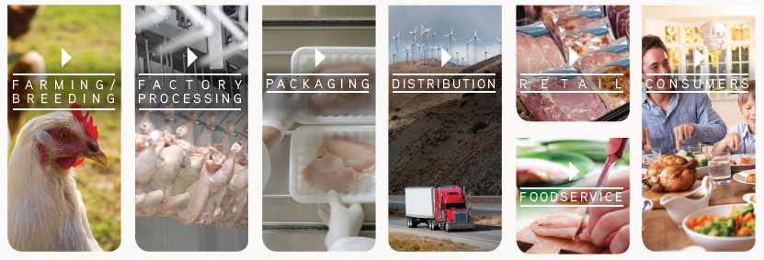
What is Food Science?
The study of all aspects of food
Raw production
Handling
Processing
Packaging
Distribution
Final consumption
9

Slide 10
What Determines Shelf Life?
All quality aspects of the food
Color
Texture
Flavor
Aroma
Nutritional Value
Food Safety
Food Spoilage
10

Slide 11
How Do We Extend Shelf Life?
By processing
Refrigeration
Freezing
Canning
Drying
Formulation (added salt, sugars, acids)
Chemical and Physical Sanitation (Blanching, Irradiation)
SANITATION
CHEMICAL
PHYSICAL
CHEMICAL
SANITIZERS
HEAT
RADIATION
WET
DRY
UV
G RAY
Non-Food Contact
Food Contact
11

Slide 12
How Do We Extend Shelf Life?
By Cleaning and Sanitation
Follow Hygiene standards (HACCP, USDA, FDA, CODEX, BRC, SQF, IFS, ISO 22000… etc.)
Proper Cleaning and Sanitation Protocols
Hygienic Design on Equipment, Building and Facilities
Personnel and Personal Hygiene Practices
Non-Food Contact (surfaces) Chemical Sanitation
Direct Food Contact (Antimicrobial Treatments)
End-To-End approach (Farm to Retail)
Internal and External Audits
12

Slide 13
How Do We Extend Shelf Life?
By Packaging
Protects and preserves the product
Improves ease of handling, distribution, and storage
Means of advertising and labeling
Extends product shelf-life, reducing waste.
13

Slide 14
How Do We Extend Shelf Life Through Packaging?
Modified Atmosphere Packaging (MAP)
- Allows for centralized packaging and distribution
- Food preservation - extends product shelf-life
Retards microbial growth
Delays senescence/ripening of fruits
Reduces transpiration
Reduces physical damage
Slows enzymatic activity
Fresh Food Category | Refrigerated Shelf Life (days)
 | Non-MAP | MAP
Fresh red meat (low O2) | 2-3 | 21
Fresh pasta | 3 | 60
Lettuce | 2-4 | 14
Cheese | 7 | 180
14

Slide 15
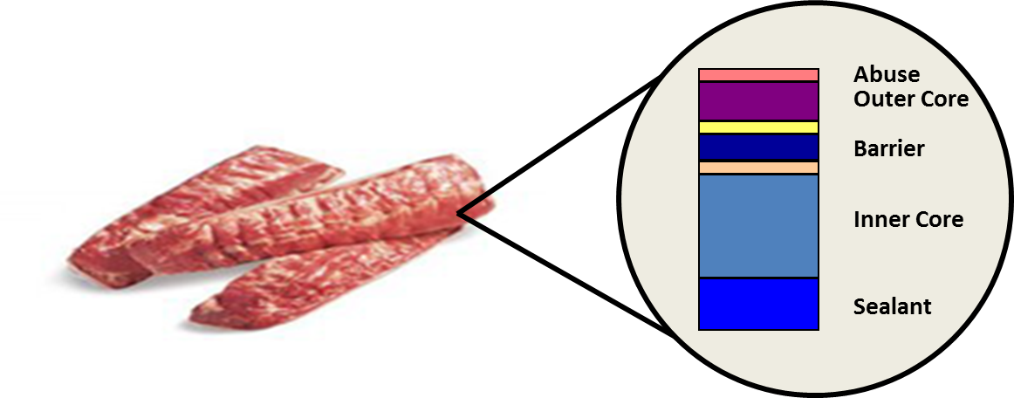
How Do We Extend Shelf Life Through Packaging?
Vacuum Packaging
Reduces the volume of air within a package
Usually requires a “barrier” material
Commonly used with Fresh Red Meats
Gas Flushing
Generally, uses a “barrier” material. Produce packaging is an exception.
Typically incorporates a pre-determined mixture of gases to dilute the atmosphere.
Packaging is engineered to withstand abuse, provide barrier and make air-tight seals
15

Slide 16
How Do We Extend Shelf Life Through Packaging?
Controlled Atmosphere Packaging
Used primarily for bulk storage and gassing
Common in the produce - fruit industry
Passive Packaging
Modification of the atmospheric concentration within a hermetically sealed package
Typical of respiring products such as fruits and vegetables
Active Packaging
Modification of the packaging material with the intent of causing some change in the package environment or packaged product.
Examples include oxygen scavenging, antimicrobials, and pathogen identification systems.
16

Slide 17
Fresh Red Meat
What are issues with FRM?
Color changes
Microbial spoilage
Rancidity
Water loss
Address through O₂ and H₂O barrier
Red Meat Color Change
Myoglobin
Oxymyoglobin
Metmyoglobin
Oxidation
17

Slide 18
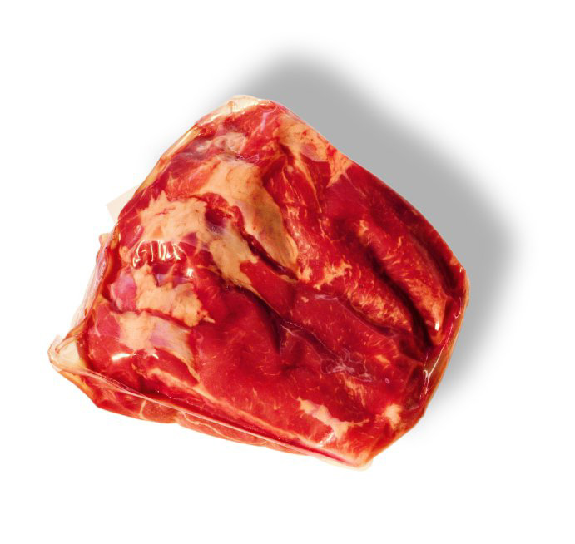
Fresh Red Meat Barrier Bag
Vacuum packaged
Prevents ingress of oxygen
- Reduce microbial spoilage
- Reduce rancidity
- Protects meat color
Reduces water loss
18

Slide 19
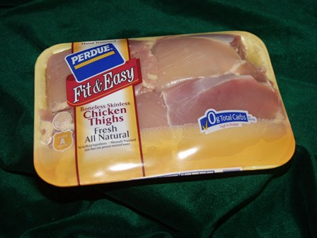
Fresh Poultry Packaging
Fresh poultry carries bacteria that break down protein and create a strong sulfur odor
- Shewanella putrefaciens
Packaged in non-barrier structures to allow odors to escape
Hermetically sealed
19

Slide 20
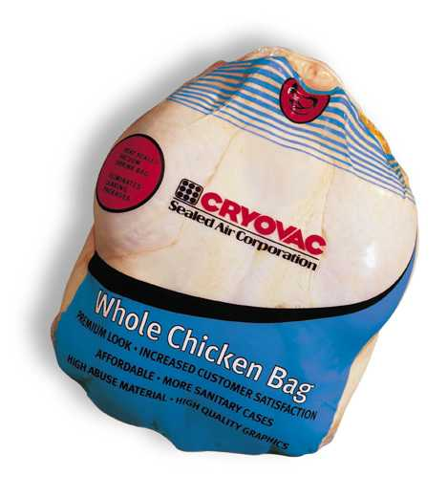
Fresh Poultry Packaging Bags
Whole birds, Turkey breasts
Breathable/ non-barrier bags
Abuse resistance
High shrink
Hermetically sealed
20

Slide 21
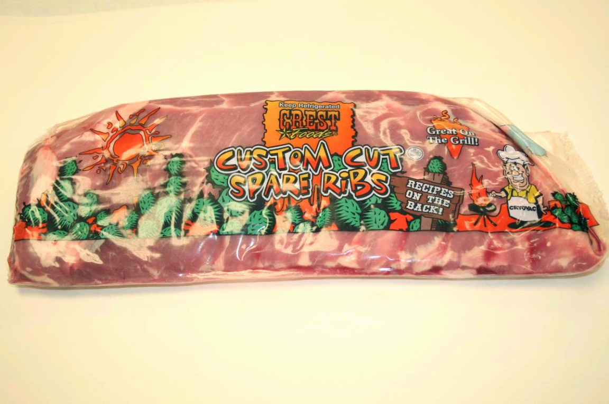
Smoked and Processed Meats Ribs Example
Abusive product (sharp bones)
Requires good oxygen barrier
Barrier bag provides O₂ barrier and abuse resistance
21

Slide 22
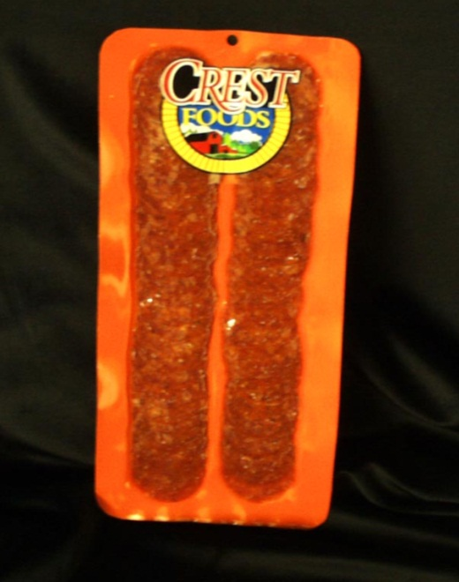
Smoked and Processed Meats Sliced Pepperoni Example
Presence of oxygen causes
- Discoloration
- Rancidity
- Mold growth
- Flavor changes
Can address by
- Vacuum package
MAP + oxygen scavenging sachet
or oxygen scavenging film
22

Slide 23
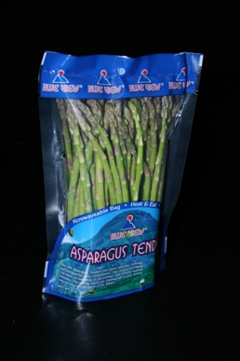
Fresh Produce
Fresh produce respires. It is “alive”.
- Uses oxygen and gives off carbon dioxide
Packaging must be permeable to allow oxygen to get to the product and carbon dioxide to escape
Packaging must be tailored to the respiration rate of the product
Different products have different respiration rates
23

Slide 24
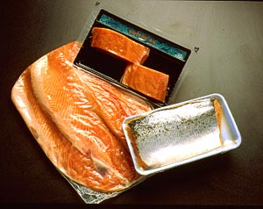
Fresh Seafood
Fresh seafood must be packaged in highly permeable material per the FDA (10K oxygen transmission rate).
This allows for safe packaging for distribution and retail display
C. botulinum concern
24

Slide 25
Food Science and Shelf Life Summary
The shelf life of various foods is determined by their composition, how they are processed and packaged, and how they are stored.
While fresh foods are desirable it is only through processing and packaging that we can extend shelf life, minimize waste, and provide good quality foods to global consumers.
25

Slide 26
Consumer Attitudes Toward Food Waste
26

Slide 27
U.S Consumers Attitudes and Behaviors
Source: Harris Poll on Consumer Food Waste (2014)
27

Slide 28
Consumer Packaging Preference
Source: Harris Poll on Consumer Food Waste (2014)
28

Slide 29
Consumer Packaging Preference
Source: Harris Poll on Consumer Food Waste (2014)
29

Slide 30
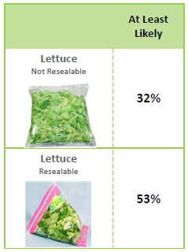
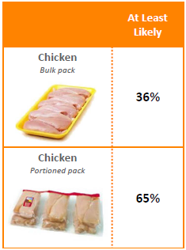
Likelihood to Reduce Waste
Resealability
Portioning
Source: Harris Poll on Consumer Food Waste (2014)
30

Slide 31
Collaborating to Reduce Food Waste
31

Slide 32
Working the Top of the Pyramid
Prevention of Food Waste
Source Reduction
Reduce the volume of food waste generated
Feed Hungry People
Donate extra food to food banks, soup kitchens and shelters
Feed Animals
Donation
Divert food scraps to animal feed
Industrial Uses
Provide food scraps for rendering, digestion and fuel conversion
Composting
Recycling
Create a nutrient-rich soil amendment
Landfill/ Incineration
U.S. EPA Food Waste Hierarchy
Last resort for disposal
Disposal
32

Slide 33
U.S. Food Waste Partnerships
Collaboration across the supply chain
Benchmarking global initiatives—driving best practices.
New linkages forming between industry, NGO's, government and academia
33

Slide 34
Conclusions
Food loss and food waste are serious problems affecting all regions of the world.
As the world’s population continues to grow more and more resources will be required to feed everyone. Land, water, fuel, fertilizer, electricity, etc.
Any food loss results in the waste of all upstream inputs, i.e. fuel, fertilizer, pesticides, water, electricity, labor. These inputs have an impact on the environment.
Packaging can reduce food loss and food waste by protecting products, extending shelf life, and providing portion control.
The effects on the environment from packaging are minor compared to the effects caused by food loss, and the associated waste of upstream inputs.
More and better education of the public is needed to facilitate an understanding of the impact each step of the food production supply chain has on the environment.

