Slide 1
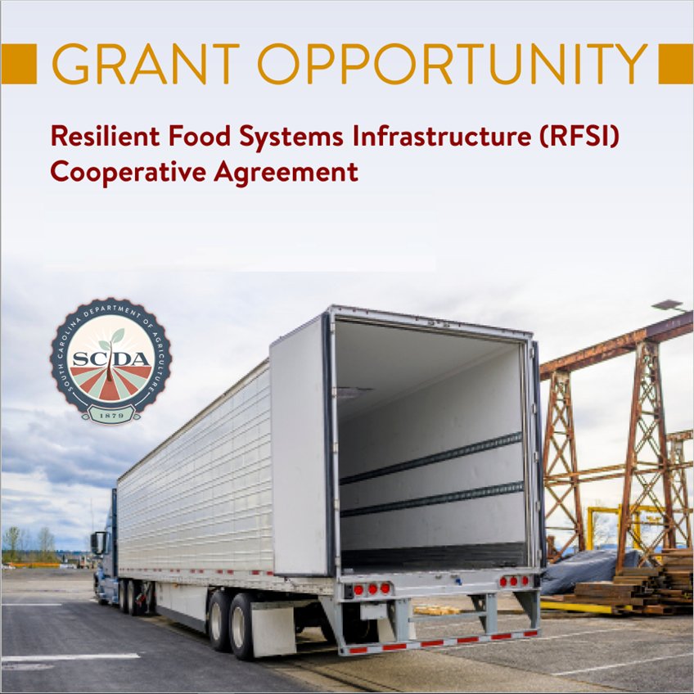

Slide 2
Resilient Food Systems Infrastructure Program
rfsi@scda.sc.gov

Slide 3
Purpose
Develop and administer state coordinated initiatives to build resilience across the middle of the State’s food supply chain for food crops.
Funds will support expanded capacity for the aggregation, processing, manufacturing, storing, transporting, wholesaling, and distribution of locally and regionally produced food products, including specialty crops, dairy, grains for consumption, aquaculture, and other food products, excluding meat, poultry, and wild caught seafood.
South Carolina has been awarded $4,983,549 to administer the program and make competitive subawards for infrastructure and equipment
Notes:
2010 - $37 billion dollars

Slide 4
Middle-of-the-supply-chain
The food supply chain involves the following stages:
1. Production, 2. Processing, 3. Aggregation/Distribution, and 4. Markets/Consumers.
For the purposes of RFSI, “middle-of-the-supply-chain” refers to the middle stages: 2. Processing and 3. Aggregation/Distribution
Grants cannot be used for production activities ex. purchase of a tractor
Notes:
2010 - $37 billion dollars

Slide 5
Who can apply for funding?
Agricultural producers or processors, or groups of agricultural producers and processors
Nonprofit organizations operating middle-of-the-supply-chain activities such as processing, aggregation, distribution of targeted agricultural products
Local government entities operating middle-of-the-supply-chain activities such as processing, aggregation, distribution of targeted agricultural products
Tribal governments operating middle-of-the-supply-chain activities such as processing, aggregation, distribution of targeted agricultural products.
Institutions such as schools, universities, or hospitals bringing producers together to establish cooperative or shared infrastructure or invest in equipment that will benefit multiple producers middle-of-the-supply-chain activities such as processing, aggregation, distribution of targeted agricultural product.
Notes:
2010 - $37 billion dollars

Slide 6
What can I use the funding for?
Expand capacity for processing, aggregation and distribution of agricultural products to create more and better markets for producers;
Modernize manufacturing, tracking, storage, and information technology systems;
Enhance worker safety through adoption of new technologies or investment in equipment or facility improvements;
Improve the capacity of entities to comply with federal, state, and local food safety requirements;
Improve operations through training opportunities;

Slide 7
What can I use the funding for?
Support construction of a new facility;
Modernize or expand an existing facility (including expansion and modifications to existing buildings and/ or construction of new buildings at existing facilities);
Construction of wastewater management structures, etc.;
Modernize processing and manufacturing equipment; and
Develop, customize, or install equipment that reduces greenhouse gas emissions, increases efficiency in water use, improves air and/or water quality, and/or meets one or more of USDA’s climate action goals.

Slide 8
Infrastructure Grants
$100,000 minimum award and $3,000,000 maximum award
Will fund projects to expand capacity and infrastructure for the aggregation, processing, manufacturing, storing, transporting, wholesaling, or distribution of targeted agricultural products
50% match requirement unless you self-identify as any of the following who qualify for a 25% match:
Beginning farmer or rancher
Veteran farmer or rancher
Limited resource farmer or rancher
Socially disadvantaged farmer of rancher
Small disadvantaged business
Women-owned small business
Historically underserved farmer or rancher
Using a USDA provided template, applicants are required to submit a project narrative that describes the overall scope of the project and how it aligns with the program goals and priorities.
The narrative must include an estimated increase in production and who will benefit from the overall project (ag producers not consumers).

Slide 9
Examples of Infrastructure Grant Projects
Expand capacity for processing, aggregation and distribution of agricultural products to create more and better markets for producers;
Modernize manufacturing, tracking, storage, and information technology systems;
Enhance worker safety through adoption of new technologies or investment in equipment or facility improvements;
Improve the capacity of entities to comply with federal, state, and local food safety requirements;
Improve operations through training opportunities;

Slide 10
Examples of Infrastructure Grant Projects
Support construction of a new facility;
Modernize or expand an existing facility (including expansion and modifications to existing buildings and/or construction of new buildings at existing facilities);
Construction of wastewater management structures, etc.;
Modernize processing and manufacturing equipment; and
Develop, customize, or install equipment that reduces greenhouse gas emissions, increases efficiency in water use, improves air and/or water quality, and/or meets one or more of USDA’s climate action goals.

Slide 11
Simplified Equipment-Only Grants
These projects offer a simplified application to fund smaller grants between $10,000 and $100,000 for equipment purchases.
The Simplified Equipment-Only option is a Fixed Price Grant, meaning it will fund only equipment purchases (and not associated facility upgrades, staffing, or other costs).
No match is required for this grant type.
Using a USDA provided template, applicants are required to submit a project narrative that describes the overall scope of the project and how it aligns with the program goals and priorities.
Applicants must attach documentation to substantiate the costs of each piece of equipment, which can include contracts, catalog pricing, or binding quotes provided by license commercial entities.

Slide 12
Examples of Simplified Equipment-Only Grant Projects
Must be within the USDA’s definition of special purpose equipment for processing, aggregation, and distribution, such as:
Canners
Hulling processors
Reverse osmosis systems
Egg packing machines
Flotation Tanks
Other processing equipment, packing and labeling equipment, or delivery vehicles

Slide 13
rfsi@scda.sc.gov
Notes:
2010 - $37 billion dollars

