Slide 1
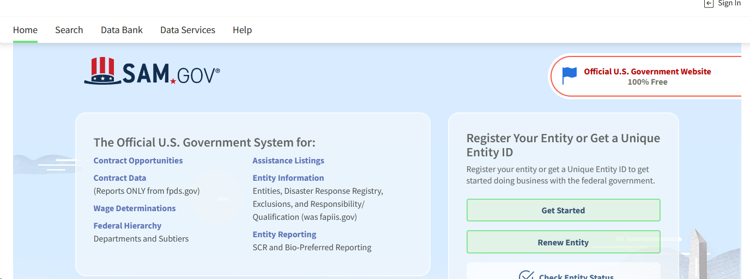
Register with SAM.GOV –

Slide 2
SAM.gov registration – or entity registration
SAM (System for Award Management)
Is a government-wide registry for vendors doing business with the Federal government,
You must register your entity (you as an individual or your organization) to be able to bid on contracts or apply for federal assistance (e.g., grants, loans) from the federal government.
Registration is Free.
SAM registration requires annual renewal

Slide 3
Register with SAM – to get UEI Number
UEI Number
Required to apply for Federal grant and funding
a Unique Entity ID is 12-digit alphanumeric code that the government owns, controls, and assigns to your business.
Provided when registering in SAM
Starting on April 4th, 2022, the government stopped using the DUNS number and replaced it with the Unique Entity ID
Typically takes 1-2 hours to apply- be prepared!

Slide 4
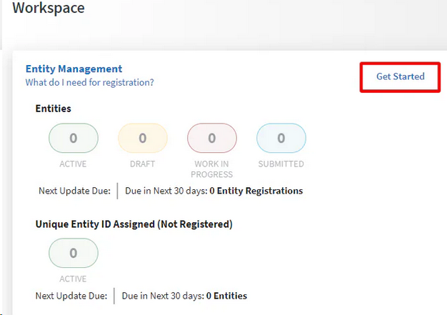
Before You Register
Gather Documentation:
Legal business name
Business Tax ID numbers
Tax statements
Bank account information and routing numbers
Company Information
Locations
Addresses
Employee Numbers

Slide 5
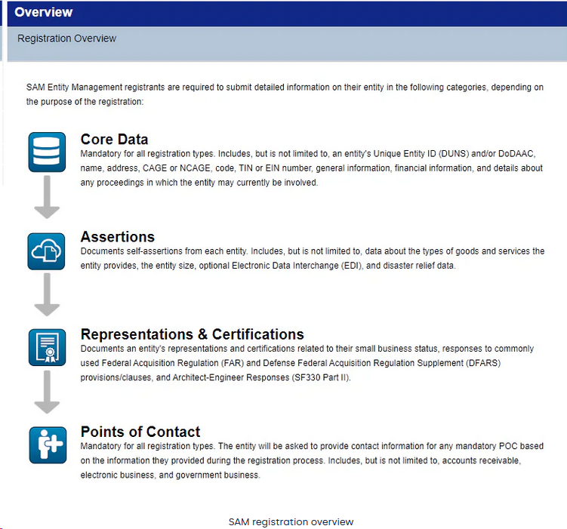
SAM.gov Registration Process
PLAN AHEAD
If everything goes well can take 10 Days to get UEI number.
If it doesn’t go well it can take much longer.
PLAN AHEAD

Slide 6
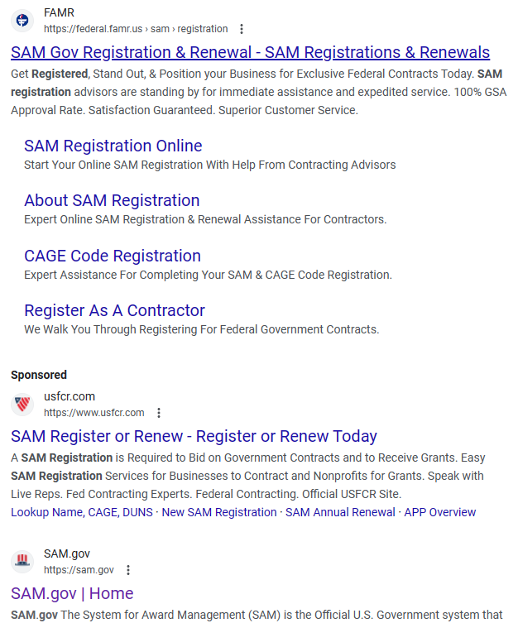
Watch Out!
There are many private sites that charge for registration.
Only use the SAM.GOV website.
SAM is ALWAYS free to register

